Slide 1
Airbnb Revenue Maximization
By
Vandana Brahmasa
Ramya Chowdary Polineni
Vimala Shravani Dodda

Slide 2
Business Problem
Airbnb hosts struggle to maximize revenue and occupancy in a competitive marketplace.
Identifying the impact of pricing strategies, property attributes, and Super host status on performance is critical.
Seasonal trends, guest reviews, and external factors like local events further complicate booking optimization.
Hosts need actionable insights to improve listing performance, while Airbnb requires strategies to enhance host engagement and guest satisfaction

Slide 3
Data source description
Superhost Evaluation: The dataset focuses on Airbnb's Superhost certification program, which evaluates hosts quarterly based on specific criteria like response rate, reviews, and cancellations. Superhost status reflects a high standard of host quality.
Temporal Scope: It includes data from eight Superhost evaluation periods (April 2017–2018, July 2016–2017, October 2016–2017, January 2017–2018). Each entry represents an active listing during a specific period.
Host and Property Metrics: The dataset features indicators like Superhost status changes, ratings, reviews, booking statistics, and property availability. These are tracked for both the current and previous evaluation periods.
Demographics and Geography: It incorporates geographic details (city, ZIP code, census tract) and demographic data (e.g., racial composition, population) associated with the property's location.
Pricing and Revenue: Metrics include nightly rates, booking prices, revenue, and occupancy rates, offering insights into financial performance and market trends. Quartiles and variance measures are provided for pricing within census tracts.
Notes:
Content to speak:
Superhost Evaluation: Data on Airbnb’s Superhost certification, evaluated quarterly based on host quality criteria.
Temporal Scope: Covers eight evaluation periods from 2016 to 2018, each representing an active listing.
Host and Property Metrics: Tracks Superhost status, ratings, reviews, bookings, and availability.
Demographics and Geography: Includes location (city, ZIP code, census tract) and demographic data.
Pricing and Revenue: Features nightly rates, revenue, occupancy, and pricing variance by tract.

Slide 4
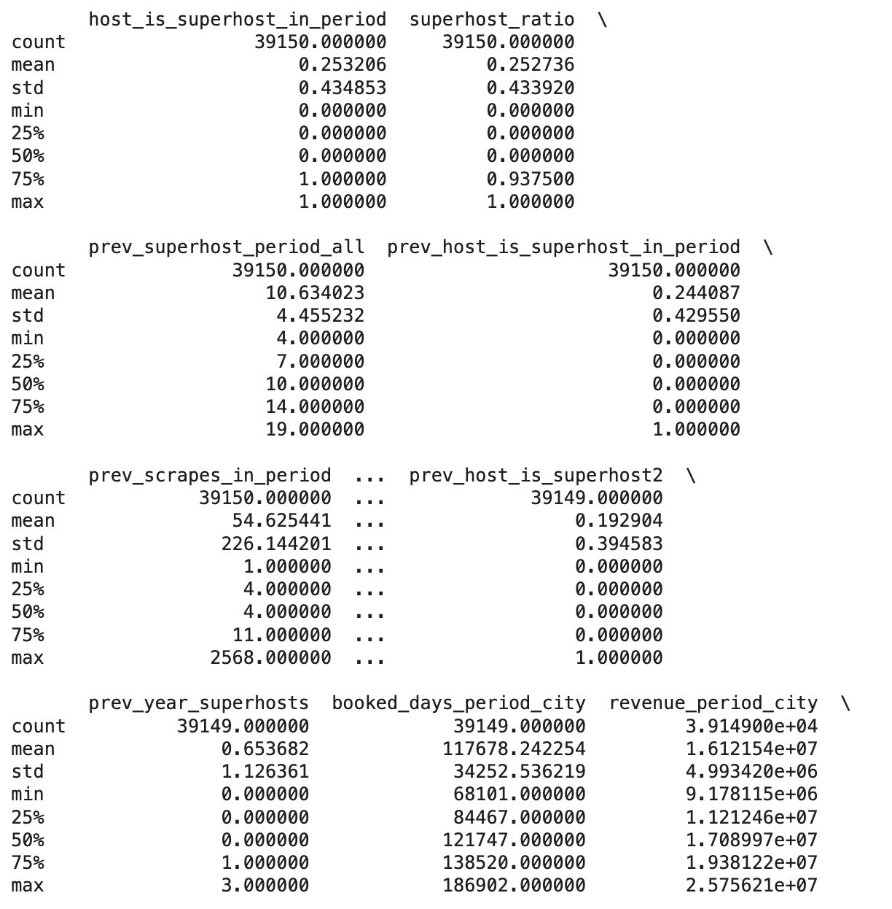
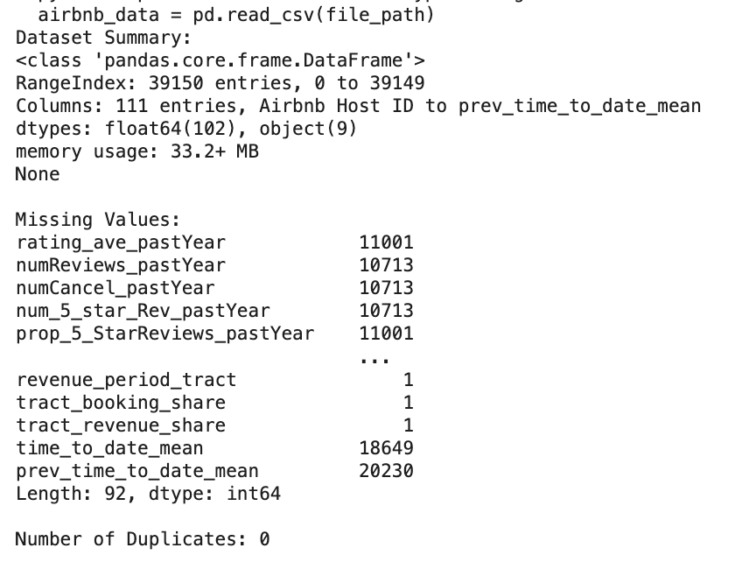
Dataset Summary
Summary Statistics:
Missing Values

Slide 5
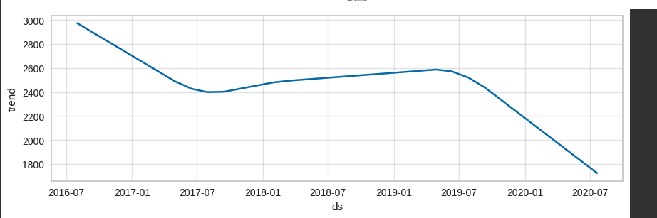
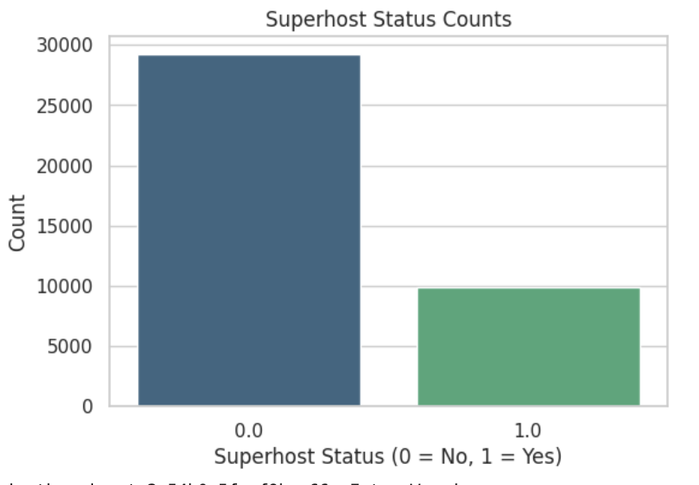
Pre-processing
Exploratory Data Analysis
Missing Data Handling:
Missing numerical values: impute median
Missing categorical values: impute mode/ create unknown column
Drop Column Integrated Property Manager since it has all missing values
Imputed missing values with the median, a robust measure that mitigates the effect of outliers
impute missing values for sequential, time-based columns (e.g., time_to_date_mean and prev_time_to_date_mean)
Categorical Columns: Imputed missing values based on the nature of the data:
Columns with fewer unique values were imputed with the mode.
Columns with many unique values were filled with the category 'Unknown'.
Outlier Handling:
Defined and implemented a Winsorization function to cap outliers in specified numerical columns (revenue, occupancy_rate, rating_ave_pastYear, numReviews_pastYear, num_5_star_Rev_pastYear) based on the 1st and 99th percentiles.
Retains valuable data points (e.g., high-revenue properties), ensuring insights remain relevant.

Slide 6
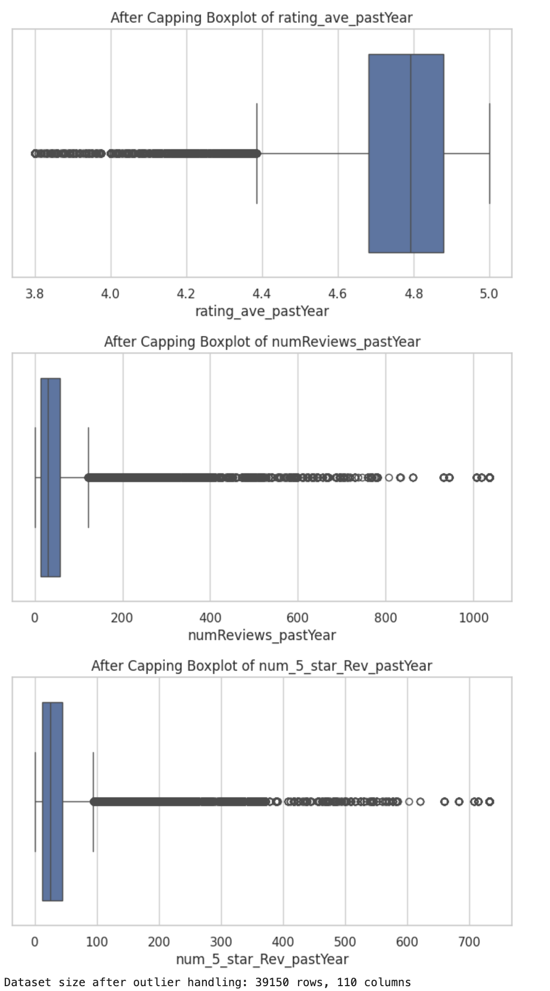
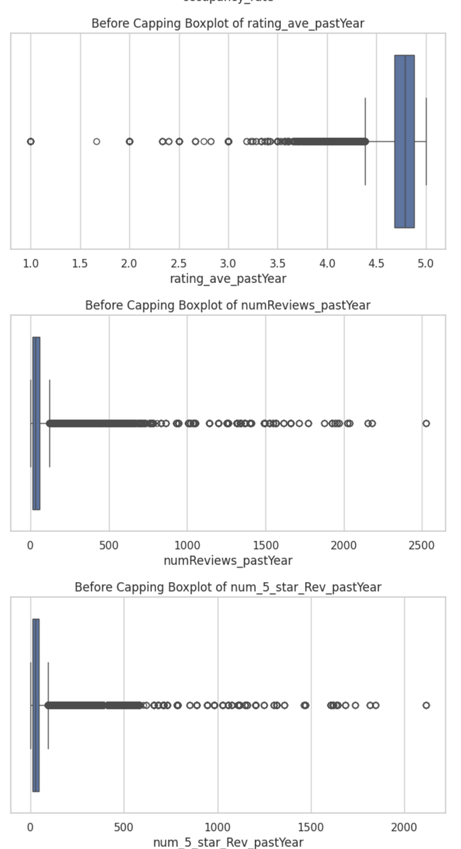
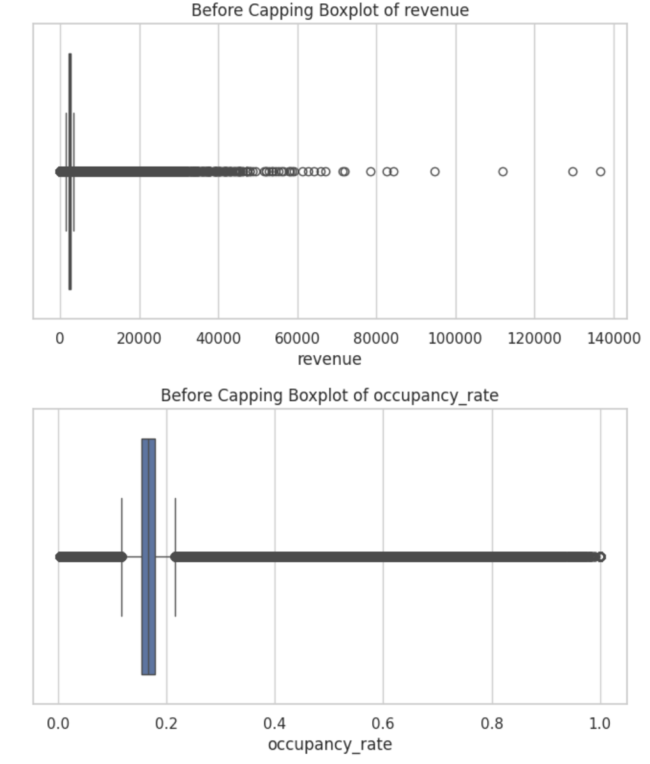
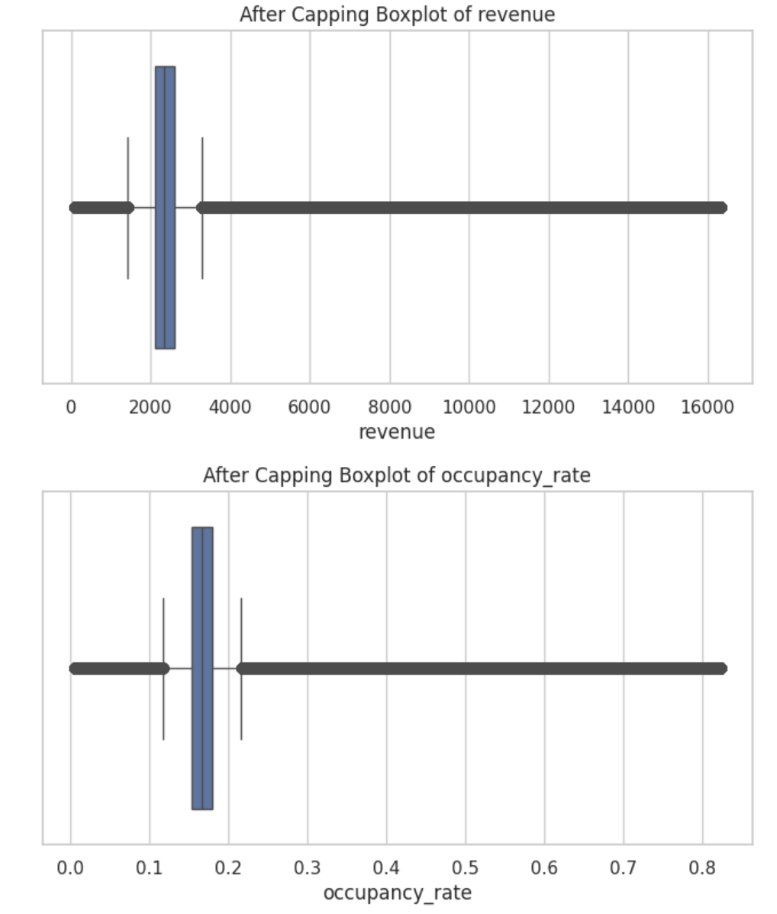
Before Winsorization
After Winsorization

Slide 7
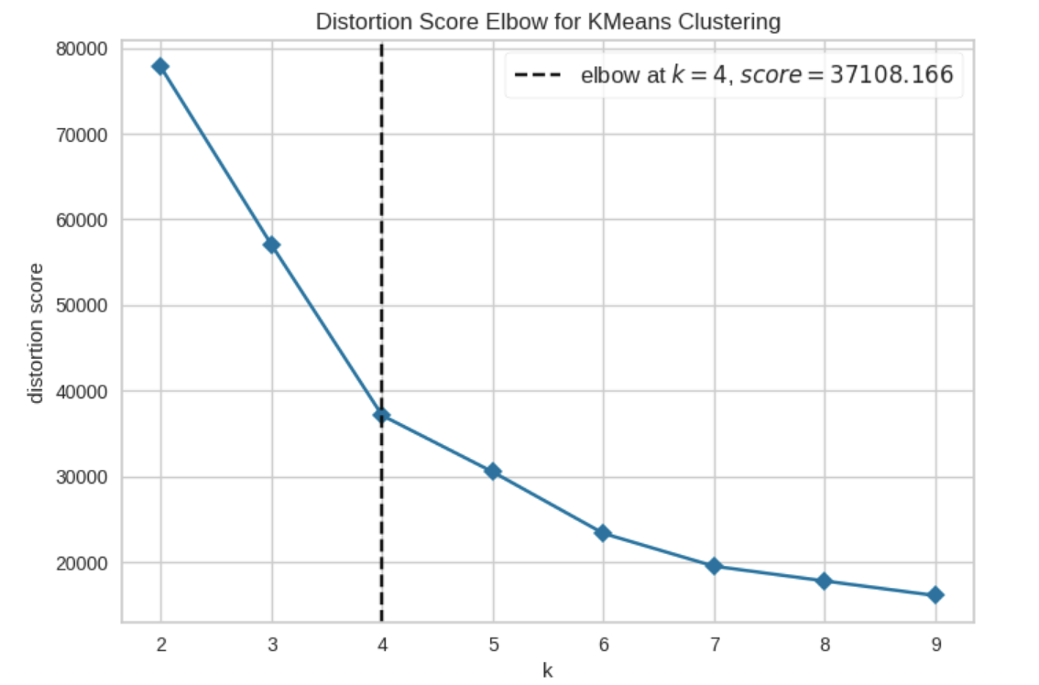
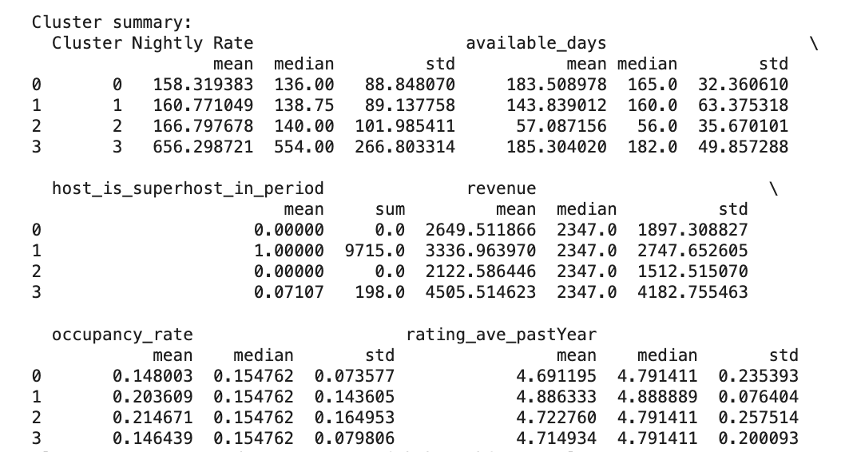
Clustering Analysis for Airbnb Data – Market Segmentation
Group Airbnb listings into distinct clusters based on features like pricing, availability, and host behavior to uncover patterns and actionable insights
Clustering with K-Means: Applied the Elbow Method (using KElbowVisualizer) to determine the optimal number of clusters based on distortion scores, then performed K-Means clustering with the identified cluster count.
General Observations
Cluster 1 (Superhost-Managed Listings):
Most consistent performers in terms of availability, revenue, and ratings. Best combination of affordability, host quality, and guest satisfaction.
Cluster 3 (Luxury Listings):
Focus on premium pricing but with limited occupancy and Superhost involvement. Caters to a niche, high-spending audience.
Cluster 2 (High Availability, Non-Superhosts):
High availability but lacks the influence of Superhosts, resulting in moderate revenue.
Cluster 0 (Budget-Friendly):
Affordable options with lower availability and ratings, targeting price-sensitive guests.

Slide 8
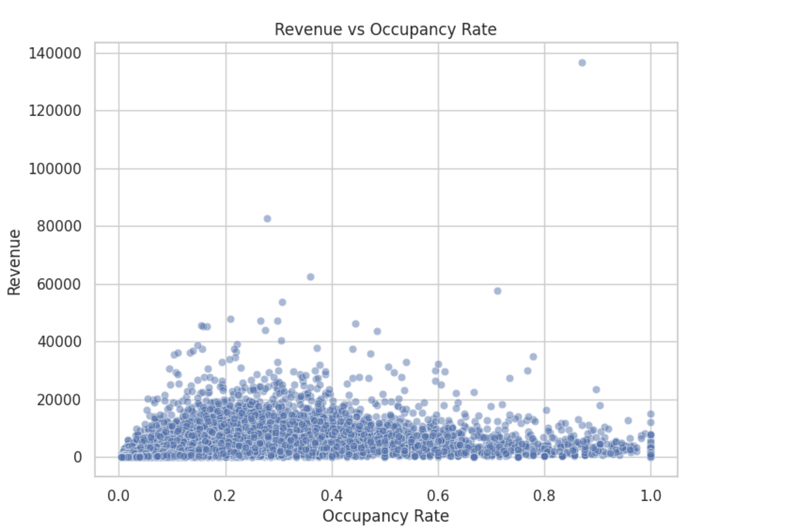
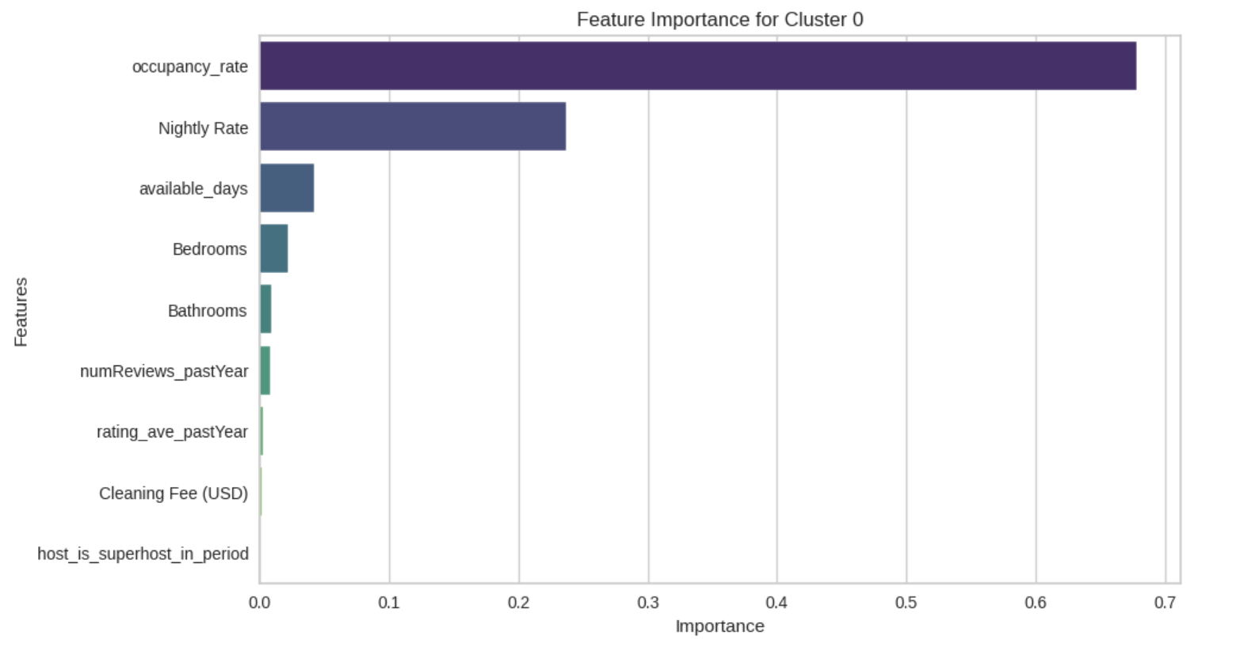
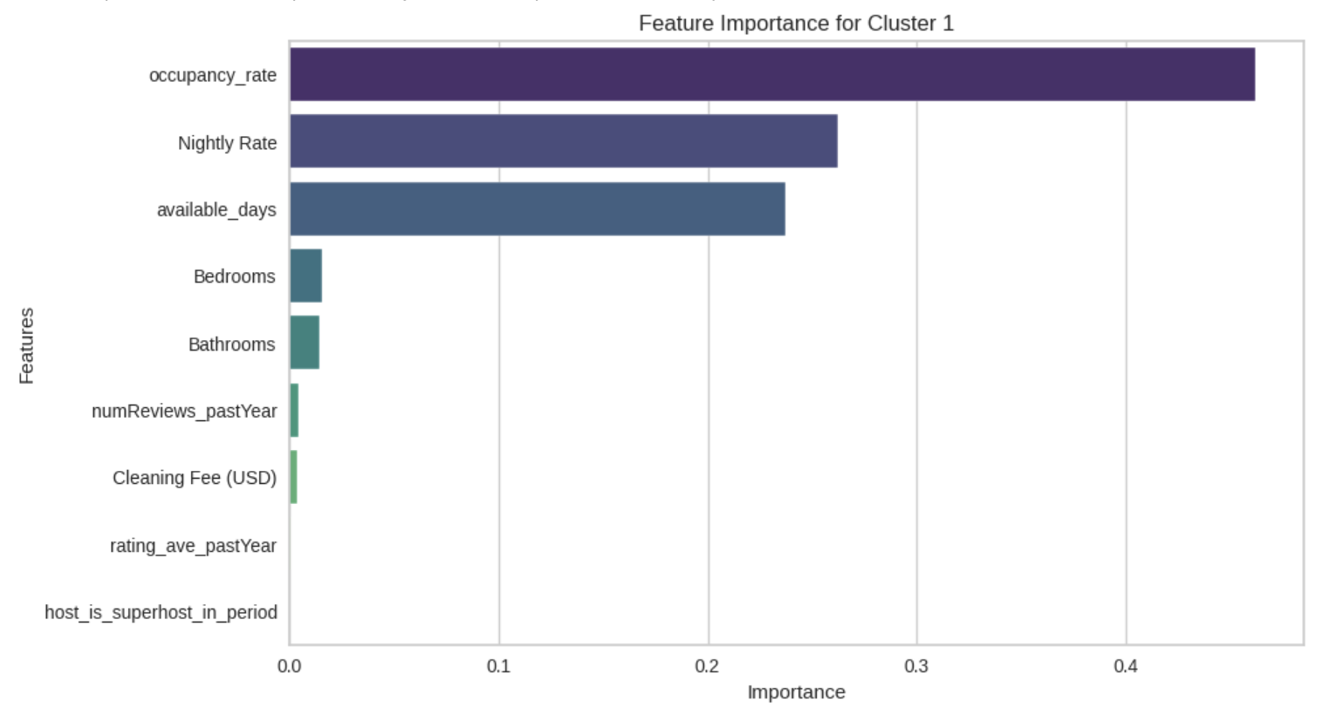
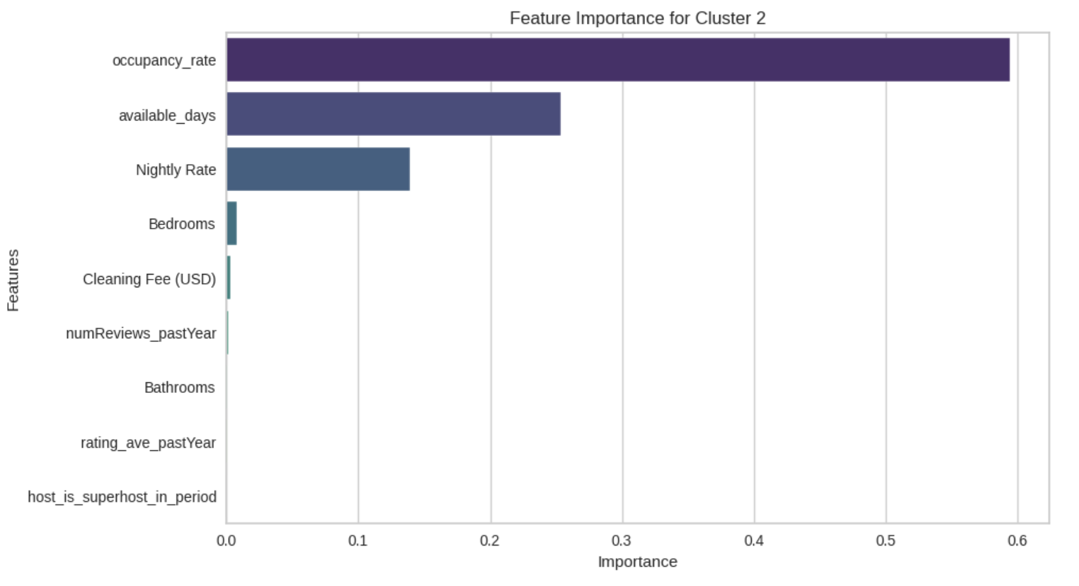
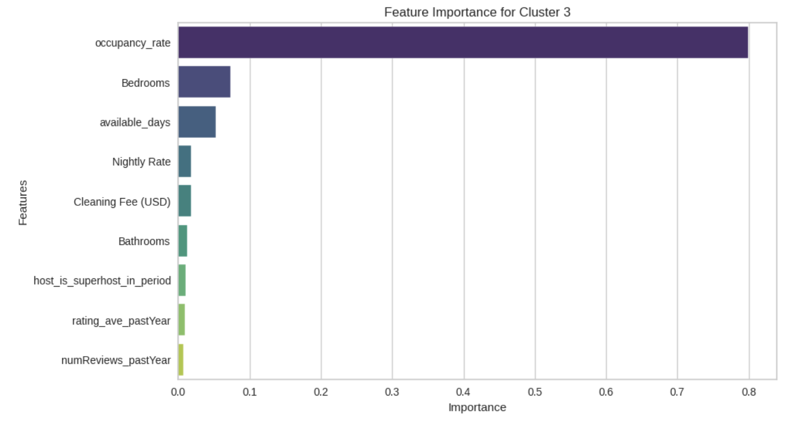
Key Drivers for Revenue – Against each cluster using Feature Importance Method
Revenue tends to increase up till 60% occupancy rate, after which, revenue is not affected even if occupancy rate increases. This suggests that while optimising occupancy rate is critical, revenue maximization is driven by other factors as well, potentially the impact of superhost status, amenities, pricing.
Results:
Since occupancy rate is the most impactful feature across the different revenue clusters, strategies should prioritize occupancy maximization, possibly through improved guest retention, superior reviews, or leveraging Superhost status.

Slide 9
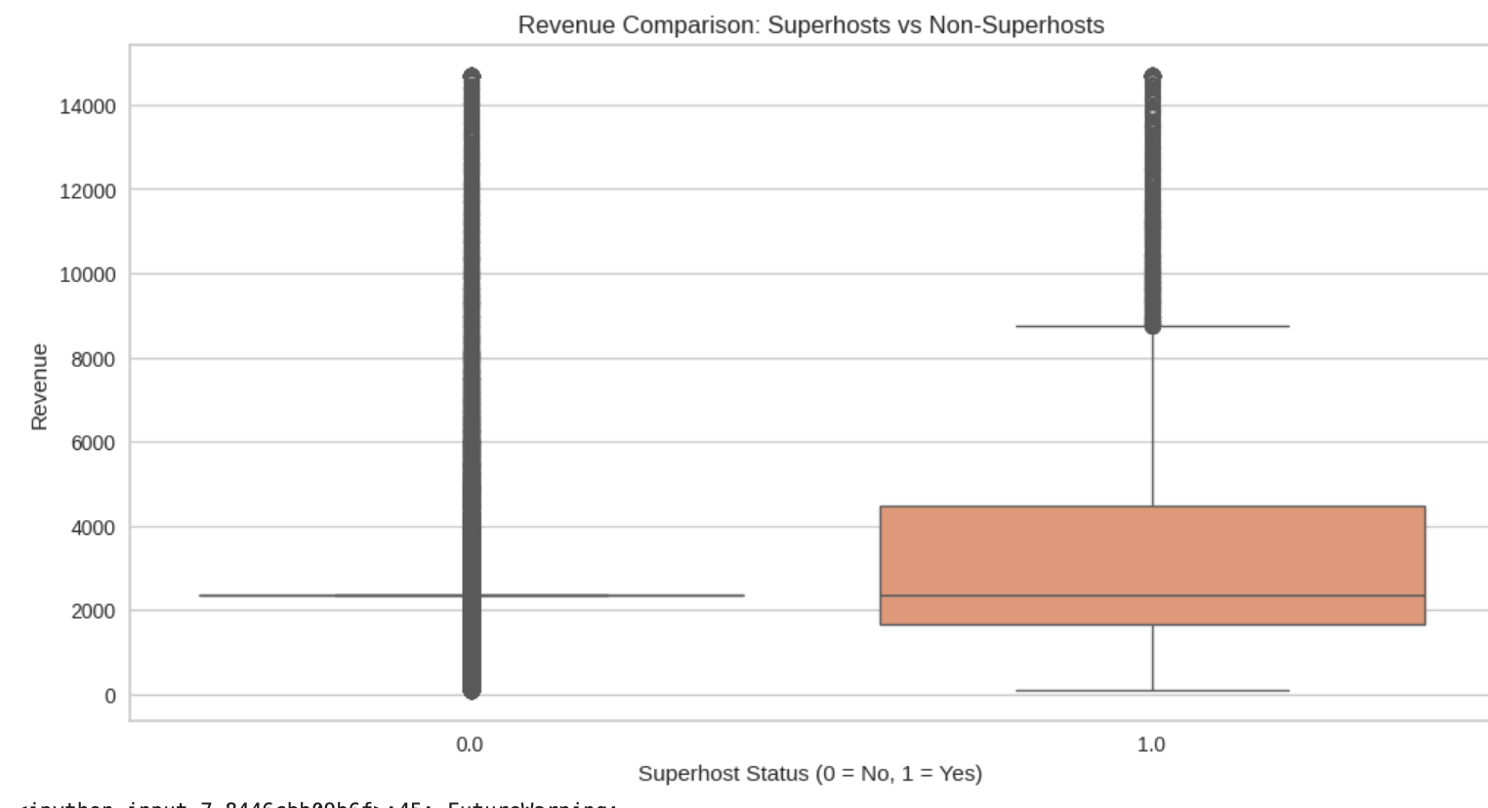
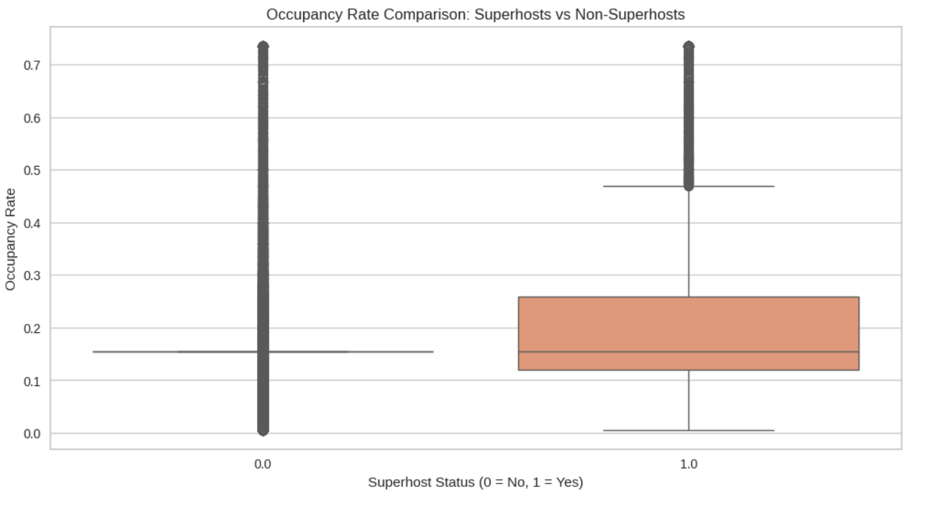
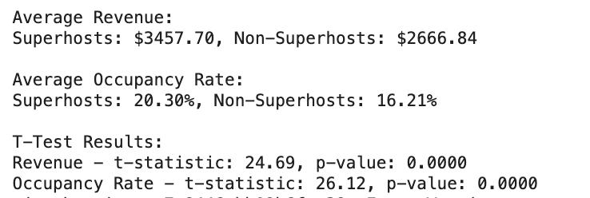
Hypothesis testing to verify the impact of super host status
Key Insights
Revenue Boost: Superhost status leads to a substantial increase in revenue. Guests may perceive Superhosts as more reliable and trustworthy, driving higher bookings.
Improved Occupancy: Higher occupancy rates for Superhosts suggest that their properties are more consistently booked, possibly due to better reviews, trust signals, or enhanced host practices.
Statistical Significance: The t-tests confirm that these differences are not due to random variation but are indeed attributable to Superhost status.
Observations:
Superhosts earn significantly more revenue on average compared to Non-Superhosts. The difference of approximately $838.81 suggests that attaining Superhost status positively impacts revenue.
Superhosts have a higher average occupancy rate, indicating better booking performance. The difference of 3.54 percentage points highlights that Superhost properties are more attractive to guests.
The p-value of 0.0000 for both tests indicates that the differences in revenue and occupancy rates between Superhosts and Non-Superhosts are statistically significant

Slide 10
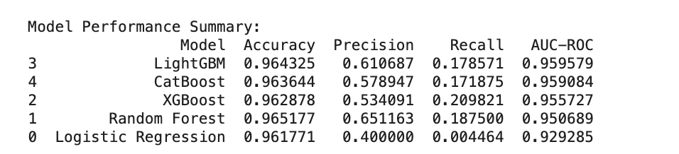
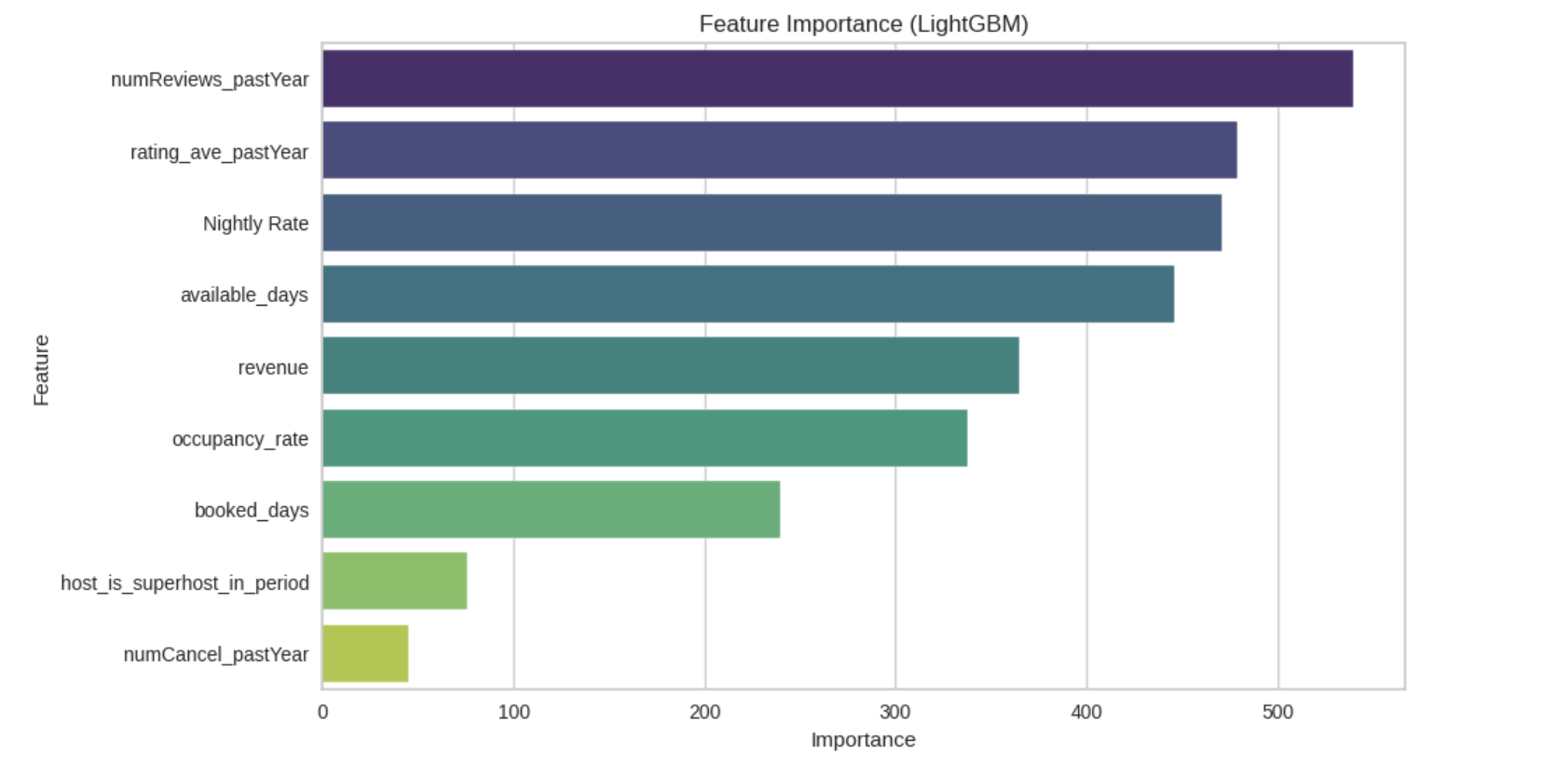
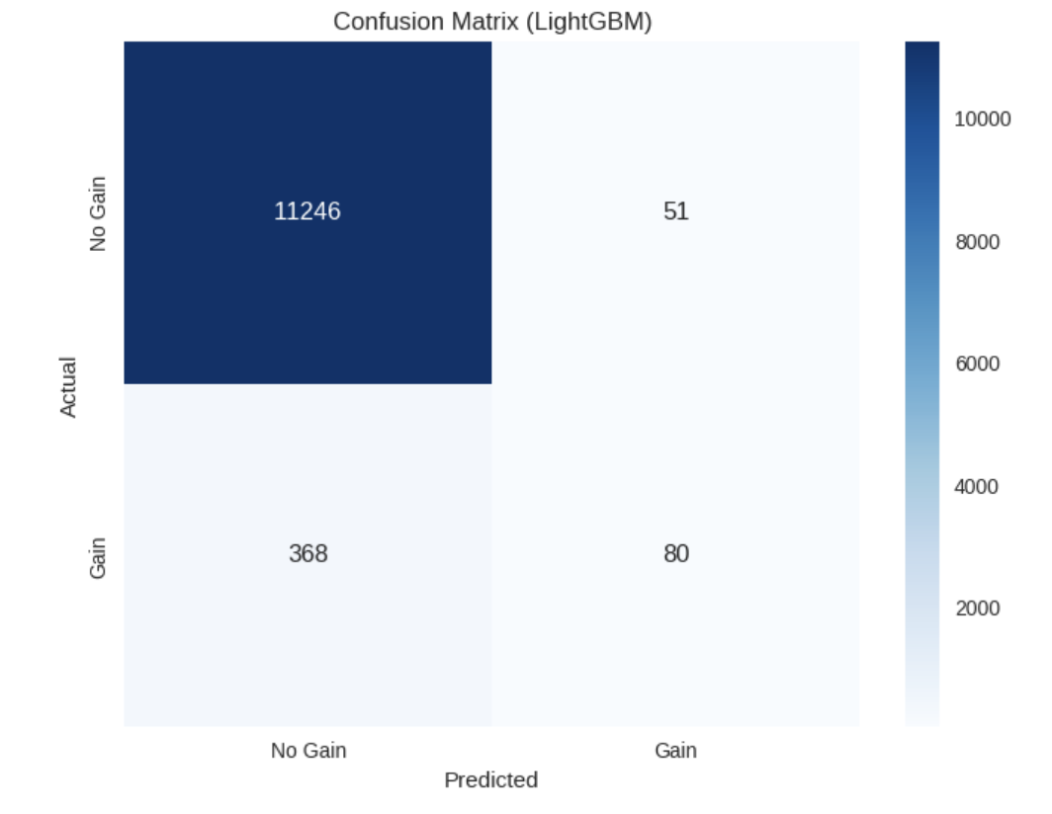
Predicting Super host Status for the next evaluation period.
Created classification models using LightGBM, Logistic Regression, Random Forest, XGBoost and selected LightGBM as best model because of it highest AUC-ROC score.

Slide 11
Interpretation of Models:
LightGBM and CatBoost: Achieve the best balance of high AUC-ROC and accuracy, making them reliable for predicting superhost status; their high AUC-ROC indicates better separation of hosts likely to gain superhost status.
Random Forest: Offers the highest precision and accuracy, minimizing false positives but slightly sacrificing recall.
Logistic Regression:
Performs poorly, failing to capture complex relationships between features and the target variable, making it less robust compared to tree-based models.
Robustness of the Results:
High AUC-ROC: All models have an AUC-ROC above 0.92, indicating strong capability to distinguish between classes.
Consistent Accuracy: Achieving over 96% accuracy, the models effectively classify the majority class.
Class Imbalance: Likely imbalance skews predictions toward the majority class
Tree-Based Models: Random Forest, LightGBM, and CatBoost provide interpretable feature importance, offering actionable insights on factors influencing superhost status.
Actionable Insights: Tree-based models provide interpretable feature importance, helping identify which factors (e.g., ratings, occupancy rates) hosts should prioritize to improve their likelihood of becoming superhosts.

Slide 12
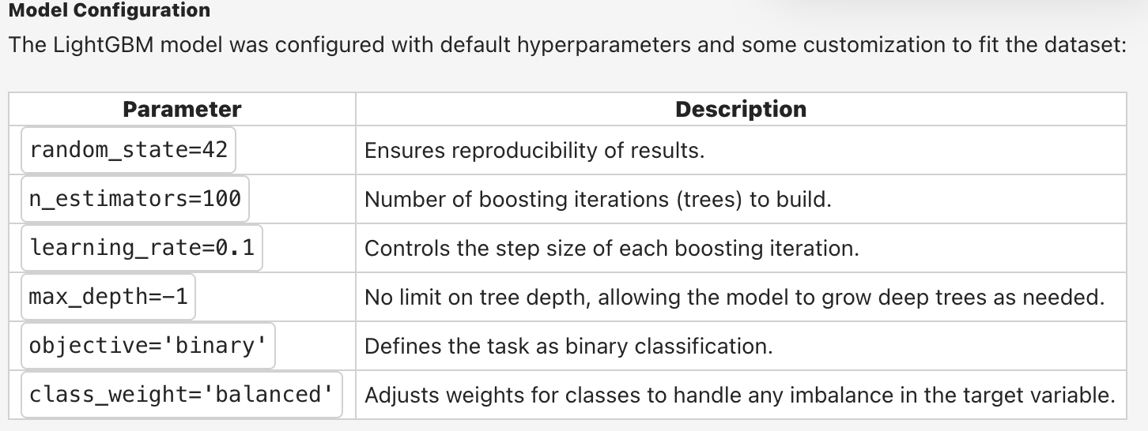
Model Description:
Key Features of LightGBM
Gradient Boosting Framework:
LightGBM builds decision trees iteratively, where each new tree corrects the errors of the previous ones.
The final model is an ensemble of these decision trees.
Leaf-wise Growth:
Unlike traditional gradient boosting, LightGBM grows trees leaf-wise, resulting in deeper trees for some branches.
This improves efficiency and accuracy, especially with imbalanced data.
Handling Large Datasets:
LightGBM is optimized for large datasets, making it suitable for the Airbnb dataset with multiple features and rows.
Feature Selection and Importance:
LightGBM inherently evaluates feature importance, helping identify key drivers of superhost status.
Speed and Memory Efficiency:
Faster training and lower memory usage compared to alternatives like XGBoost.

Slide 13
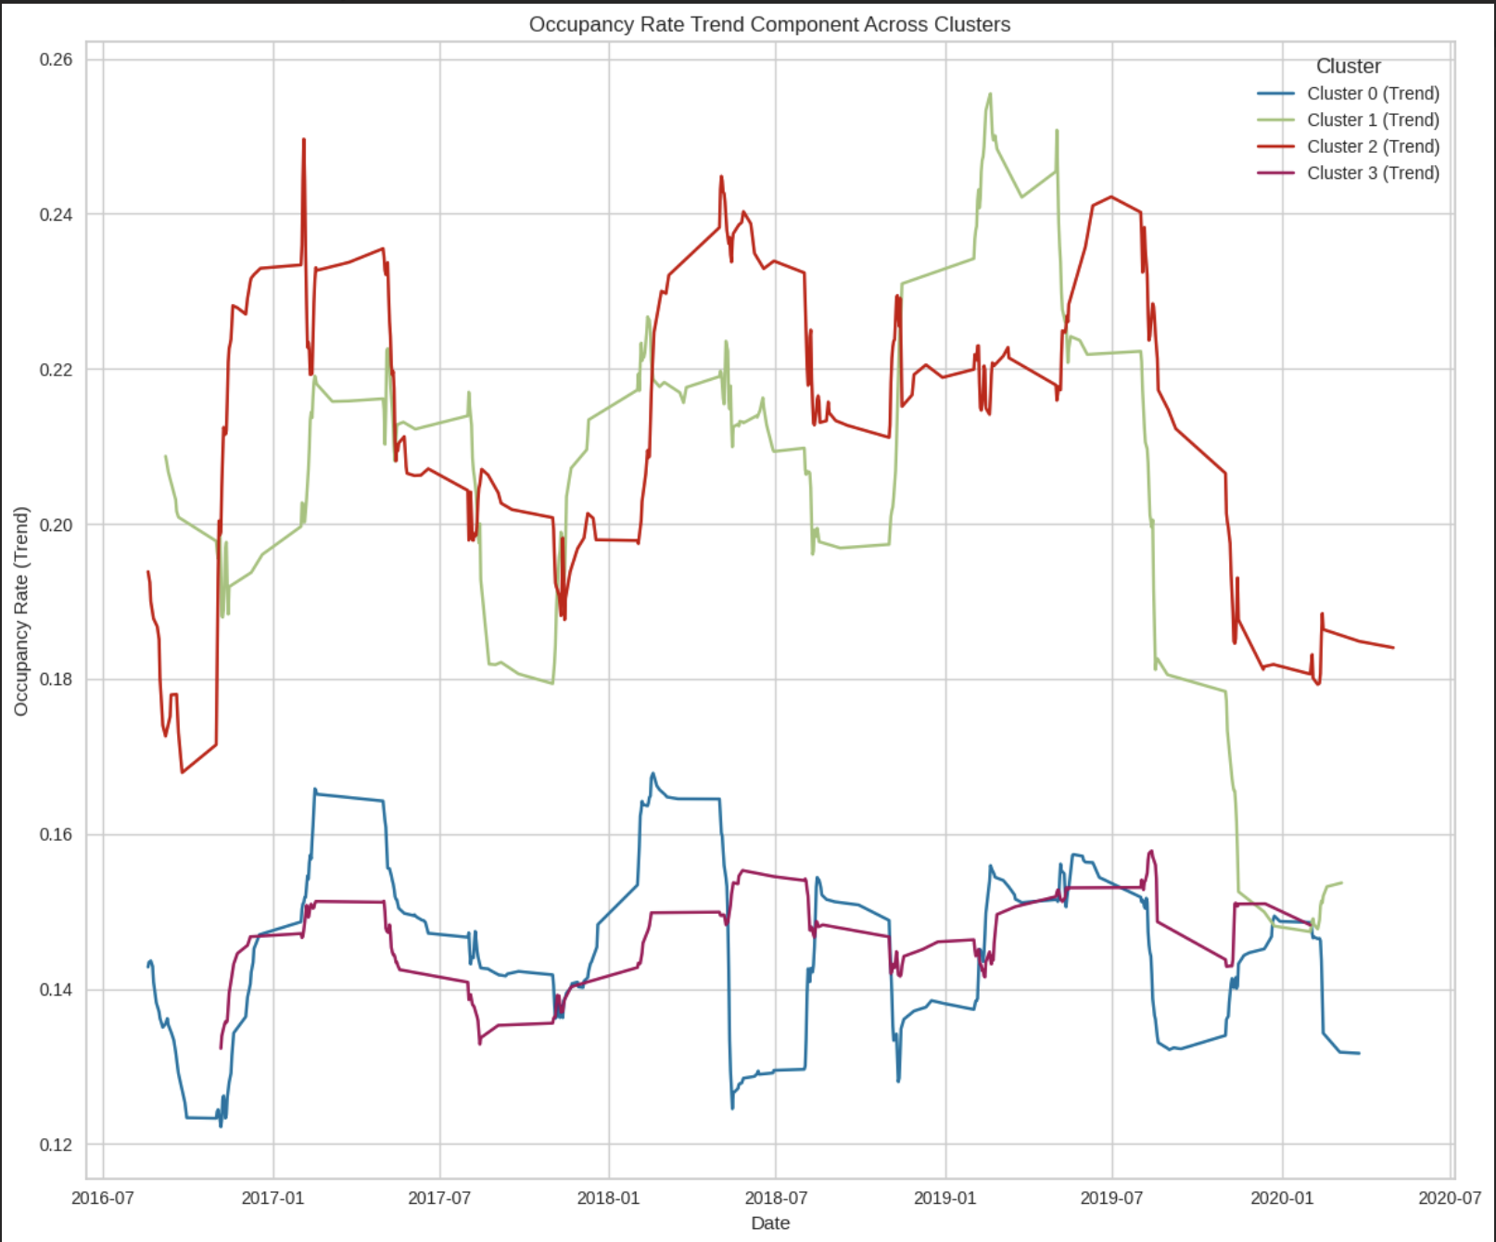
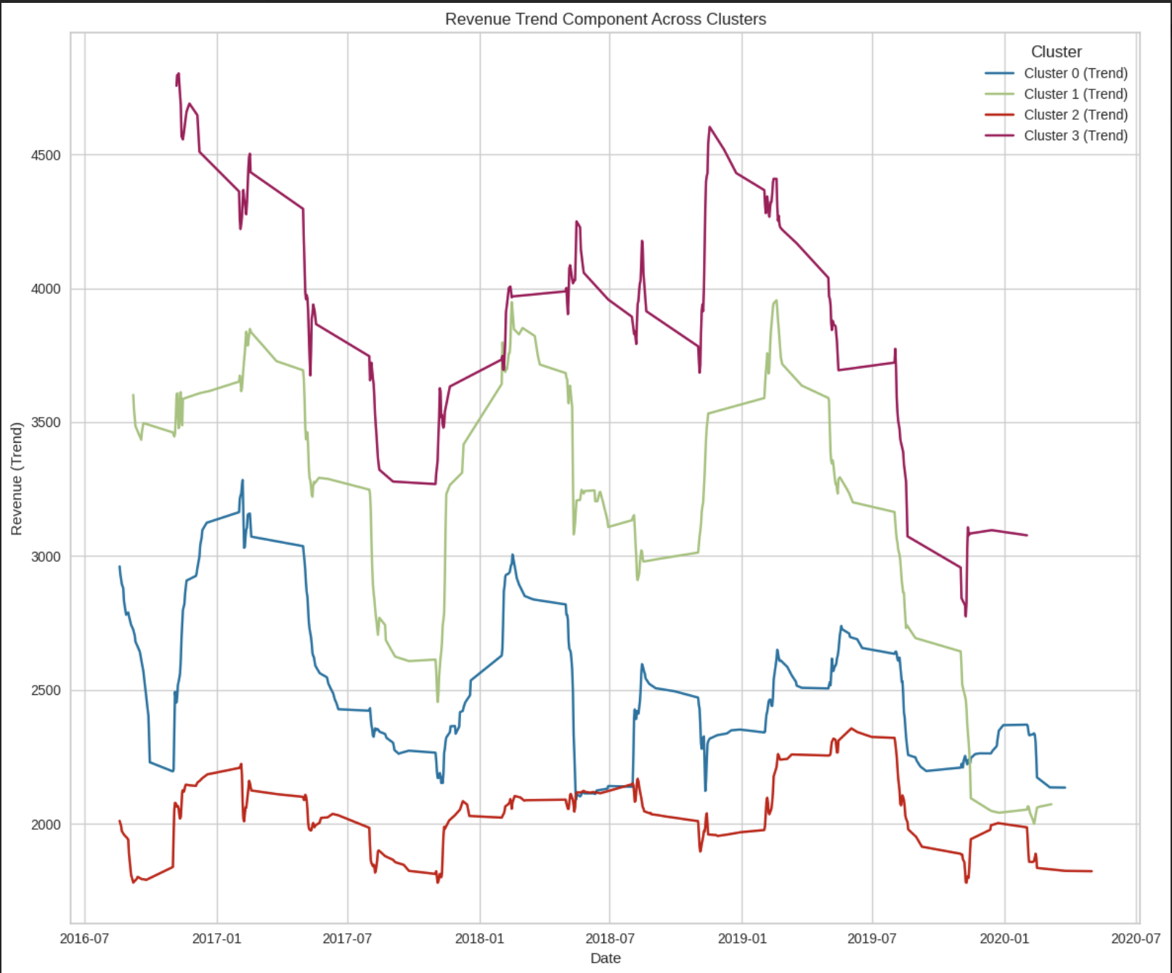
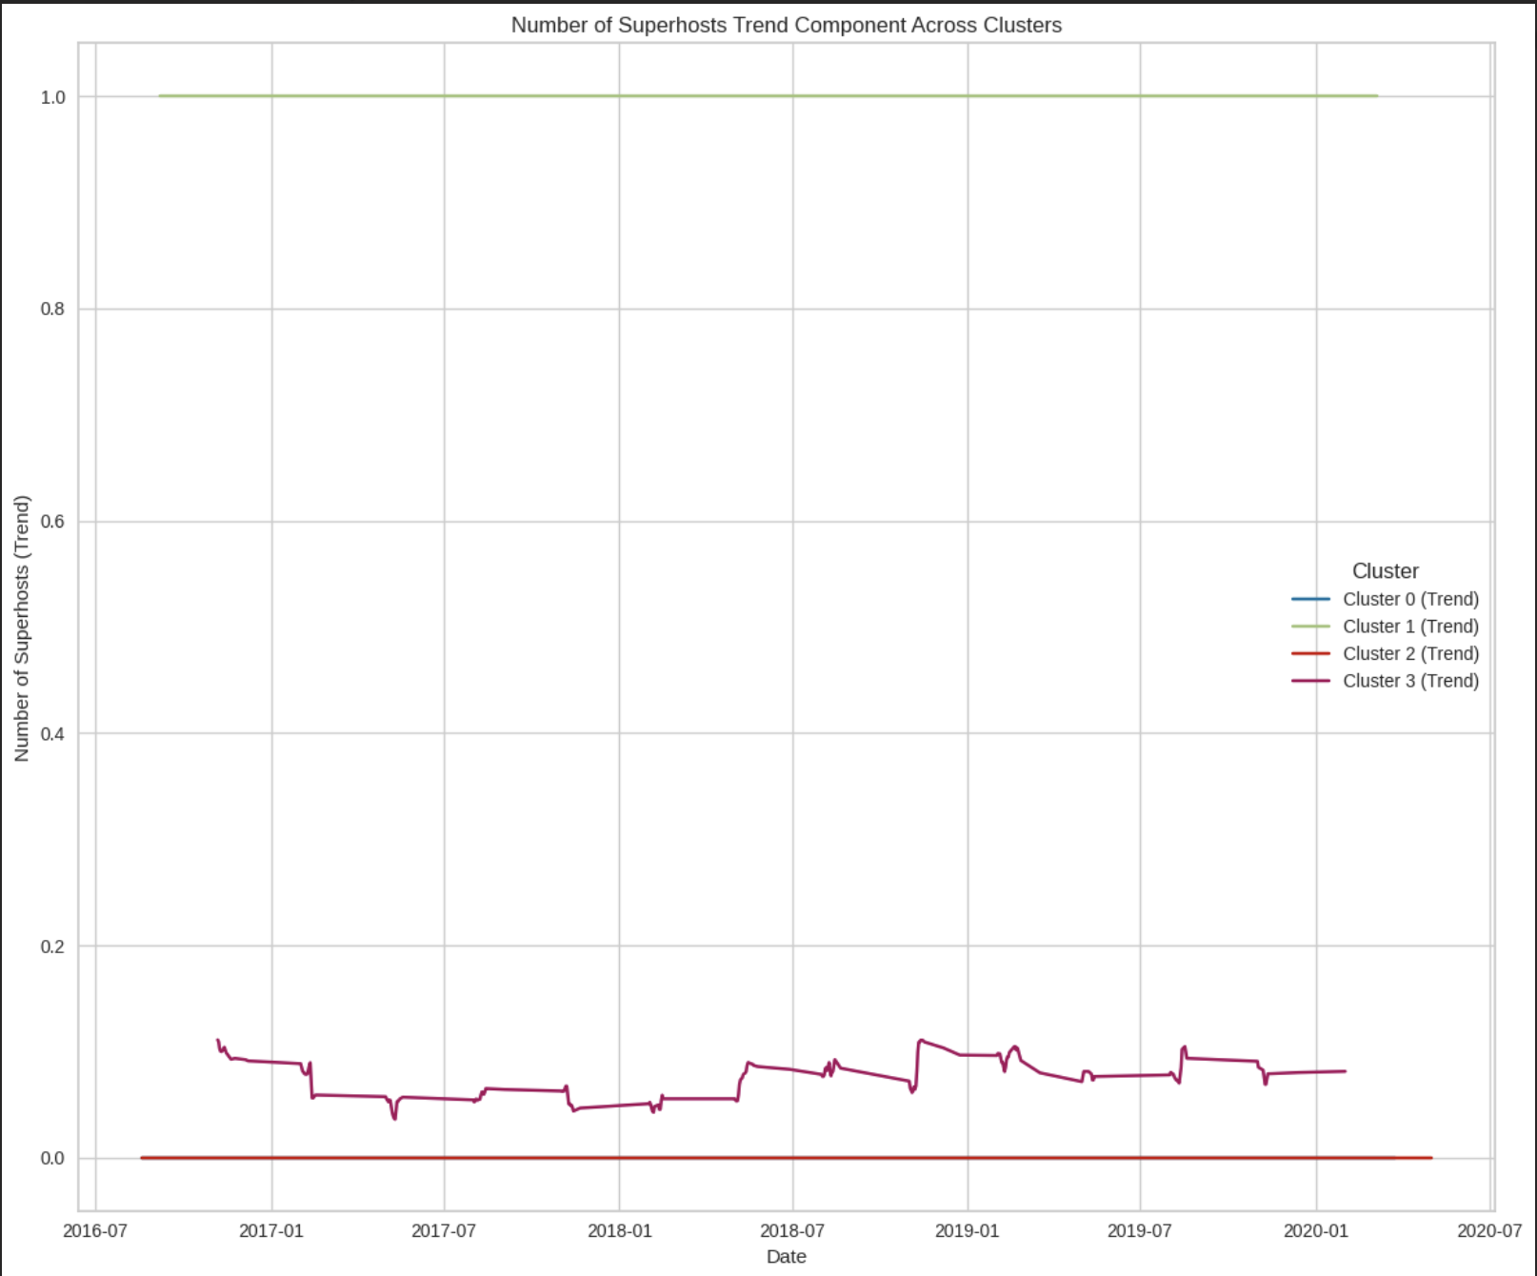
Cluster Level analysis for occupancy rate and revenue rate and no. of super hosts:

Slide 14
Cluster | Characteristics | Insights | Recommendations
Cluster 0 (Budget-Friendly) | - Nightly Rate: Mean: $162.47, Median: $130.0 - Availability: Mean: 56.55 days, Median: 55 days - Superhost Status: Mean: 0.0 (No Superhosts) - Revenue: Mean: $2165.15, Median: $2341.0 - Occupancy Rate: Mean: 24.57% - Ratings: Mean: 4.73 | - Budget-friendly properties with limited availability and lower ratings. - Moderate revenue constrained by availability. | - Increase availability to capture more bookings. - Focus on improving ratings to attract more guests. - Target price-sensitive travelers. | Low and steady, with minimal seasonal variation. | Lowest revenue across all clusters, no significant peaks. | Minimal or no superhosts.
Cluster 1 (Superhost-Managed) | - Nightly Rate: Mean: $162.69, Median: $130.0 - Availability: Mean: 142.8 days, Median: 161 days - Superhost Status: Mean: 1.0 (All Superhosts) - Revenue: Mean: $3471.91, Median: $2341.0 - Occupancy Rate: Mean: 21.33% - Ratings: Mean: 4.88 | - High-quality listings managed by Superhosts. - Strong revenue and highest ratings. - Moderate pricing with high availability. | - Market as reliable, high-quality options for general audiences. - Maintain high standards to sustain ratings and revenue. | Moderate occupancy with clear seasonal trends and significant peaks during holidays. | Moderate revenue with peaks during high-demand seasons but significant declines during off-peak times. | Strong presence of superhosts.
Cluster 2 (High Availability, Non-Superhosts) | - Nightly Rate: Mean: $174.82, Median: $139.0 - Availability: Mean: 183.1 days, Median: 163 days - Superhost Status: Mean: 0.0 (No Superhosts) - Revenue: Mean: $2780.62, Median: $2341.0 - Occupancy Rate: Mean: 15.76% - Ratings: Mean: 4.71 | - Higher pricing and availability. - Lack of Superhost involvement limits occupancy and ratings. - Moderate revenue. | - Encourage Superhost participation to improve occupancy and ratings. - Optimize pricing for better revenue generation. | High fluctuations in occupancy with distinct seasonal patterns and sharp drops during off-peak times. | High revenue with significant peaks during holidays but sharp declines afterward. | Minimal or no superhosts.
Cluster 3 (Luxury Listings) | - Nightly Rate: Mean: $940.57, Median: $850.0 - Availability: Mean: 184.9 days, Median: 163 days - Superhost Status: Mean: 0.056 (Few Superhosts) - Revenue: Mean: $3841.07, Median: $2341.0 - Occupancy Rate: Mean: 15.99% - Ratings: Mean: 4.79 | - Premium-priced luxury listings. - High revenue driven by pricing despite lower occupancy. - Limited Superhost involvement. | - Target affluent travelers with tailored marketing. - Explore strategies to increase Superhost participation. - Highlight exclusivity in advertising. | Stable occupancy with minimal seasonal variation. | Highest overall revenue, consistent across the year. | Few superhosts, despite strong revenue performance.

Slide 15
Implications for Competitors and Market
The findings and insights derived from the cluster-based time series analysis of occupancy rates, revenue, and the number of superhosts offer several implications for Airbnb businesses, competitors, and the broader market.
For Businesses | For Competitors | For the Market
Invest in dynamic pricing and revenue management systems. | Benchmark against top-performing clusters (Cluster 3). | Promote innovative models to address seasonal demand gaps.
Improve property features and marketing for Cluster 0. | Target underperforming Airbnb segments (Cluster 0). | Develop incentives for long-term or stable customer segments.
Leverage superhost branding to build trust and loyalty. | Focus on gaining superhost status for hosts. | Educate the market about property quality and guest experiences.
Expand into stable markets like Cluster 3 for diversification. | Capture demand in seasonal peaks (Cluster 2). | Monitor trends to avoid oversaturation in high-performing clusters.

Slide 16
Executive Summary and Findings
This analysis addresses Airbnb's challenges in revenue maximization and occupancy optimization by leveraging data-driven insights.
Clustering revealed four distinct property segments, with Superhost-managed listings showing the highest revenue and occupancy. Revenue peaks at 60% occupancy, with Superhost status adding ~$838 and 3.54% higher bookings on average.
Seasonal trends emphasize the importance of dynamic pricing and event-based marketing. Predictive modeling with LightGBM achieved an AUC-ROC > 0.92, identifying key factors for attaining Superhost status.
Recommendations include dynamic pricing, Superhost-focused strategies, and tailored property improvements based on market segmentation. These findings guide hosts and Airbnb in enhancing performance and guest satisfaction.

Slide 17
Background Slides
Market Positioning Recommendations
Adopt Dynamic Pricing Models:
Use historical occupancy and revenue patterns to implement a dynamic pricing strategy that maximizes revenue during high-demand periods and remains competitive during off-seasons.
Focus on Superhost Status:
Properties with Superhost status generally see higher revenue and occupancy. Encouraging hosts to achieve and maintain this status can significantly improve market positioning.
Enhance Seasonal and Event-Based Marketing:
Tailor marketing efforts to highlight unique features during peak seasons and key local events. This could involve offering special packages, discounts, or promotional campaigns.
Property Differentiation by Cluster:
Encourage hosts to enhance property features (e.g., amenities, cleanliness, number of bedrooms) based on cluster-specific trends to appeal to target audiences.
Long-Term Sustainability:
Address declining peak revenue by emphasizing guest retention (e.g., loyalty programs), improving guest experience, and leveraging positive reviews for sustained growth.

Slide 18
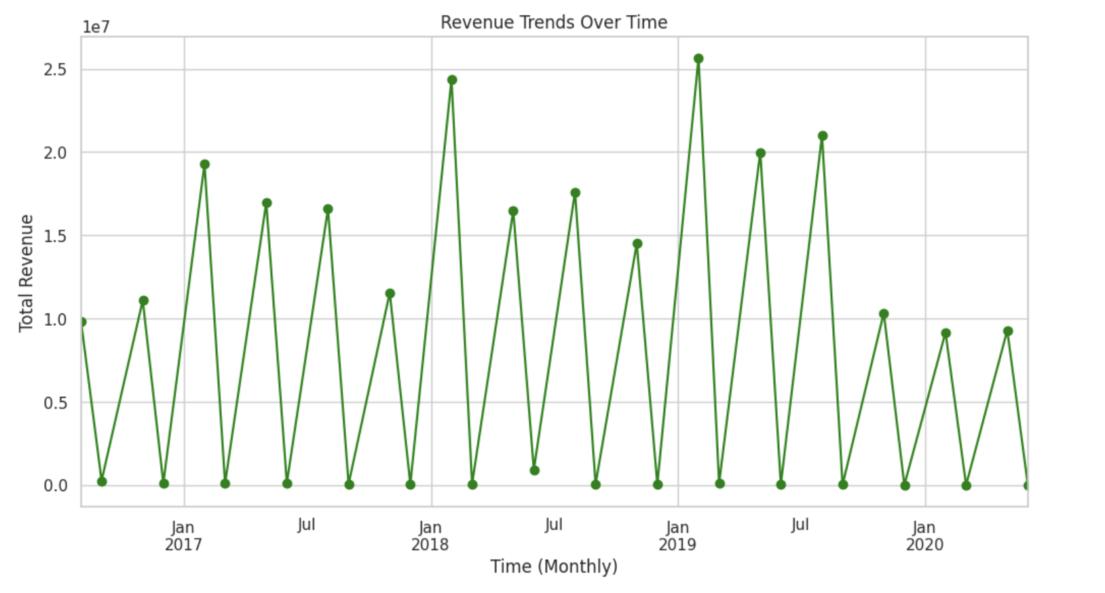
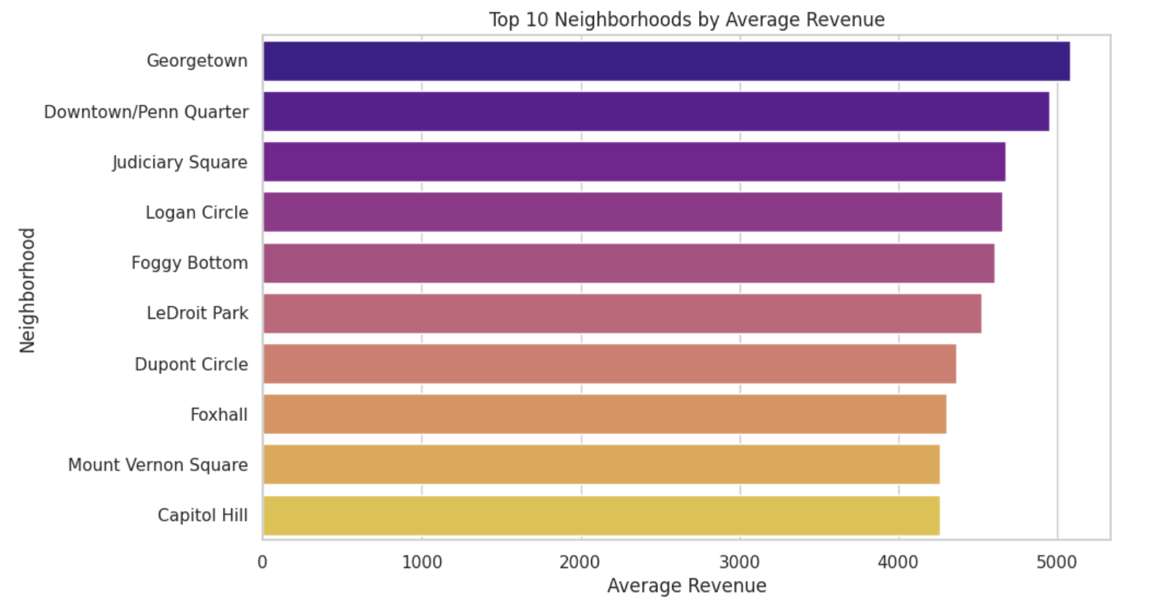
Background Slides for EDA:

Slide 19
Aspect | Insights | Recommendations
Revenue Drivers | - Occupancy rate is the strongest revenue driver across all clusters. - Pricing and availability have varying importance depending on the cluster. | - Focus on balancing pricing and occupancy optimization. - Strategic availability during peak demand seasons.
Cluster Differentiation | - Cluster 0: Budget-friendly properties with high reliance on occupancy. - Cluster 1: Flexible pricing for mid-tier guests. - Cluster 2: Balance of price and quality. - Cluster 3: High-end/luxury properties relying on consistent bookings. | - Cluster-specific strategies: Cluster 0: Promotions and Superhost focus. Cluster 1: Flexible pricing. Cluster 2: Competitive pricing. Cluster 3: Luxury amenities.
Seasonality | - Revenue spikes in January and July. - Declining peak revenue over time (possibly due to market saturation or economic factors). | - Leverage high seasons with promotions. - Focus on unique offerings to attract guests during off-peak seasons.
Strategic Opportunities | - Budget-friendly: Maximize occupancy. - Mid-tier: Flexible pricing. - Value-oriented: High availability and marketing. - Luxury: Retain high occupancy and premium pricing. | - Tailor pricing and marketing to cluster-specific trends. - Highlight unique property features in advertising.
Geographic Positioning | - High-revenue, low-occupancy properties suggest opportunities for premium pricing. - Low-revenue, high-occupancy properties need pricing optimization. | - Analyze geographic trends to find high-performing areas. - Encourage differentiated pricing strategies for high and low-performing neighborhoods.
Challenges | - Many properties have occupancy rates below 40%. - Declining revenue over time suggests competition or external challenges. | - Implement dynamic pricing to improve low-performing properties. - Target local events to boost occupancy and revenue.

Slide 20
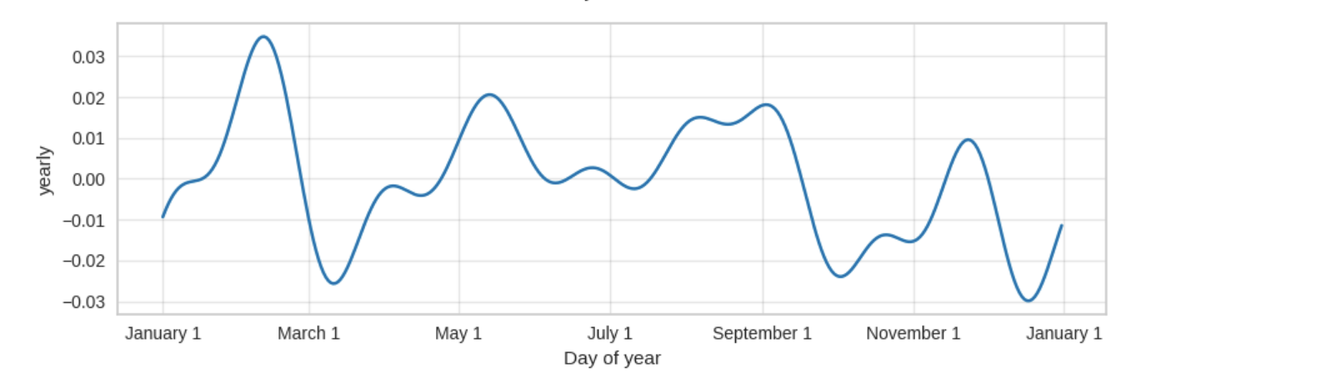
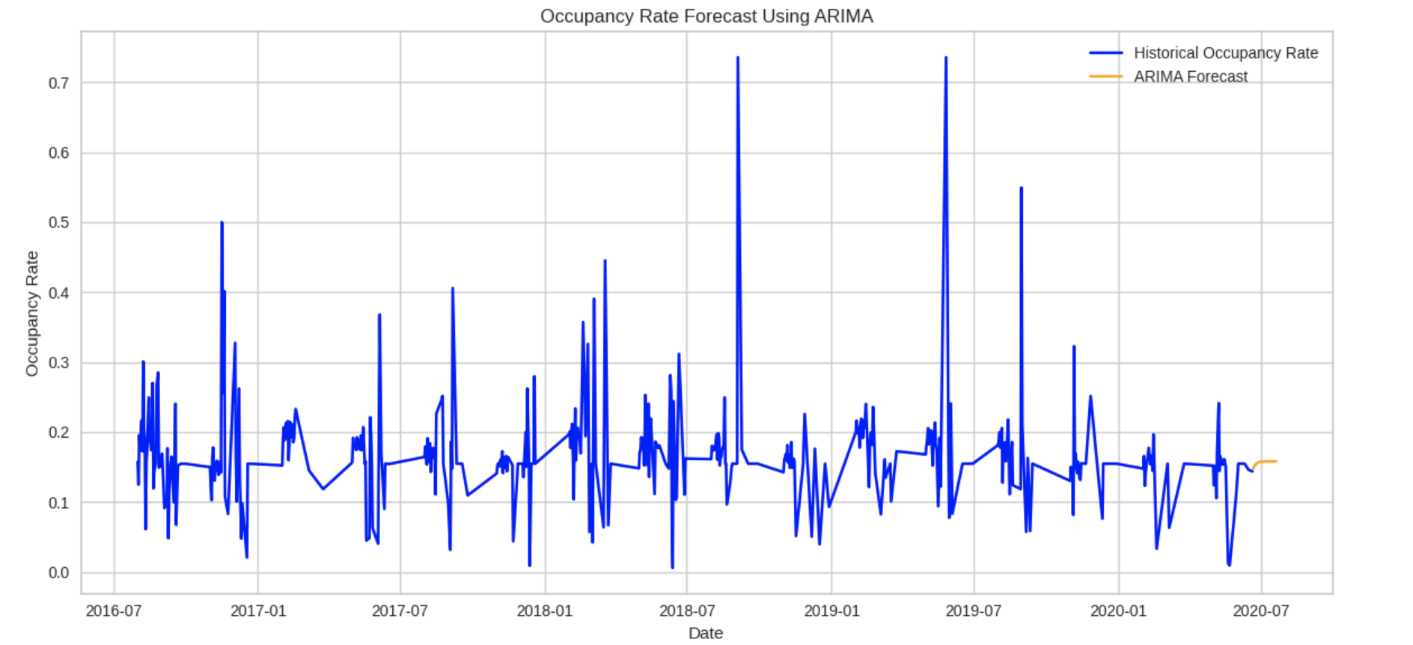
Seasonal Trends:

